Slide 1
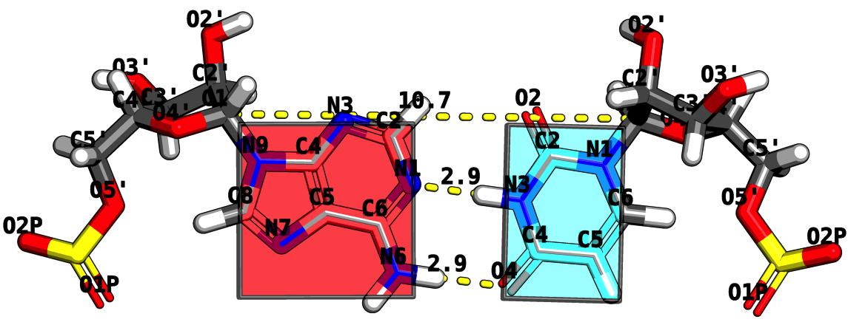
RNA Structure Analysis via the Rigid Block Model
Mauricio Esguerra
October 5th, 2010
Chemistry and Chemical Biology Department
Rutgers, The State University of New Jersey

Slide 2
Program
Opening Act
THE CHALLENGE: How does RNA fold?
Act I
BASE STEPS: Dinucleotide step classification using single-stranded base step parameters.
Act II.
BASE PAIRS: Base pairs in RNA helical regions.
Act III
BASE PAIR STEPS: From local to global properties in RNA with the aid of rigid-blocks.
Act IV
RNA STRUCTURAL MOTIFS: RNA structural motifs identification using rigid-blocks.
Finale
Notes:
Change it to Act I, Act II, etc. → Intermezzo.

Slide 3
Opening ACT
THE CHALLENGE:
How does RNA Fold?
Is this an easy or hard problem?

Slide 4
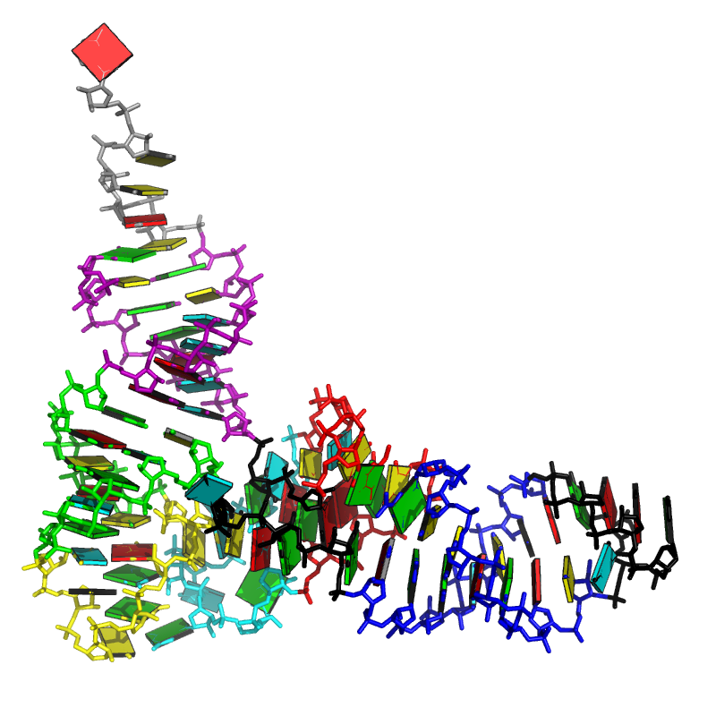
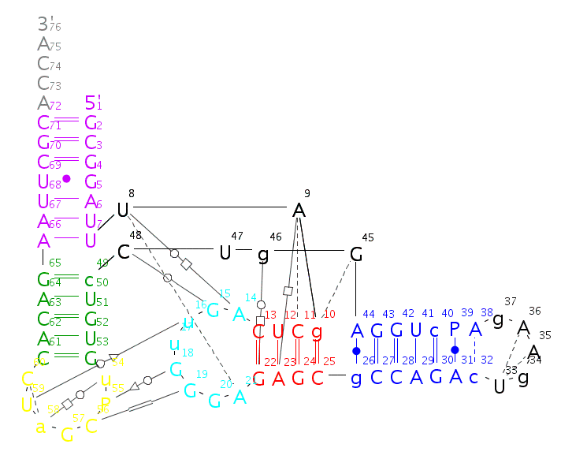
CHALLENGE How does RNA Fold?
GCGGAUUUAGCUCAGUUGGGAGAGCGCCAGACUGAAGAUCUGGAGGUCCUGUGUUCGAUCCACAGAAUUCGCACCA

Slide 5
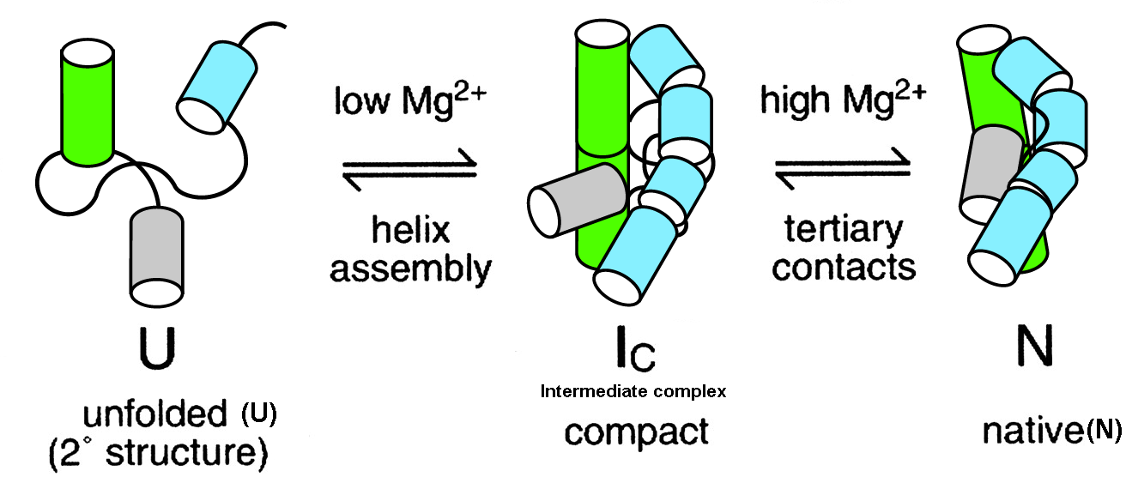
CHALLENGE Is RNA folding a hard or easy problem to solve? After all, the RNA alphabet has only 4 words.
No hydrophobic surface burial.
Polyanionic sugar-phosphate backbone.
Secondary and tertiary separated by Mg2++ addition.
Notes:
Too long.
Have the CHALLENGE IN ALL TO CONNECT TO OUTLINE!

Slide 6
CHALLENGE Usual ways to classify RNA conformations and an unexplored one -- the rigid-body perspective --.
The atom-based perspective
Comparison of backbone atom xyz.
Comparison from set of backbone, sugar, base, atoms xyz.
The bond-based perspective
Covalent bonds – backbone + glycosidic torsions.
Pseudo-bonds η and θ.
Hydrogen bonds forming in edge boundaries (Watson-Crick, Sugar, and Hoogsten).
The rigid-body-based perspective
Base-pair parameters.
Base-pair (base) step parameters.

Slide 7
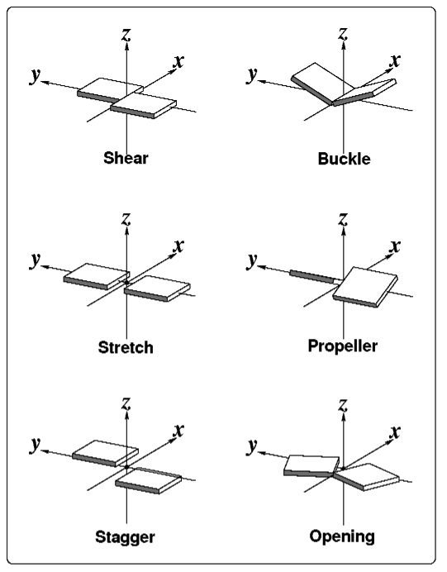
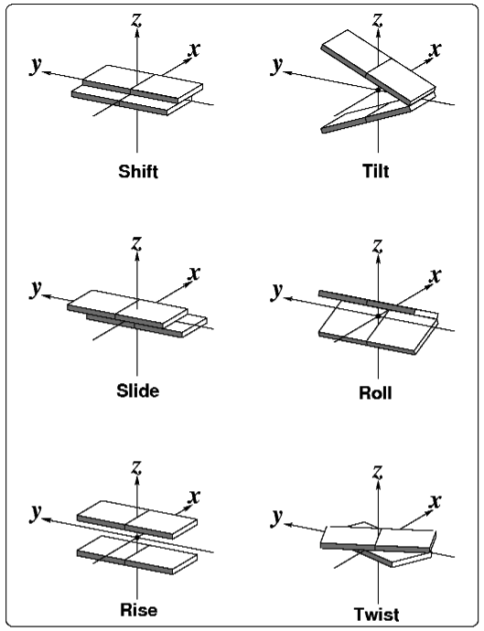
CHALLENGE The mechanical perspective: Nucleic acid bases seen as rigid-bodies.
Base-pair parameters
Base-pair-step parameters

Slide 8
ACT I
Dinucleotide step classification using single-stranded base step parameters
Notes:
Look at what is before ACT, to give it a name as motivation.

Slide 9
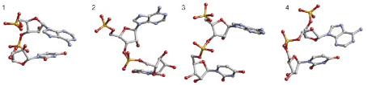
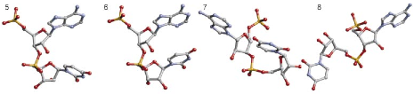
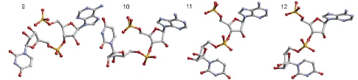
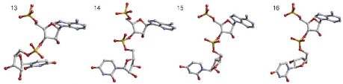
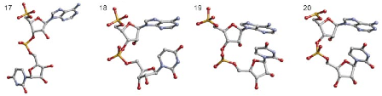
BASE STEPS 18 non-A-RNA, AII-RNA, and canonical A-RNA conformers kindly provided by Berman and collaborators.
Schneider et al. (2004) NAR, 32, 1667-1677.
Notes:
Schneider et al. structures with the original numbering. Don’t forget to write kindly provided by.

Slide 10
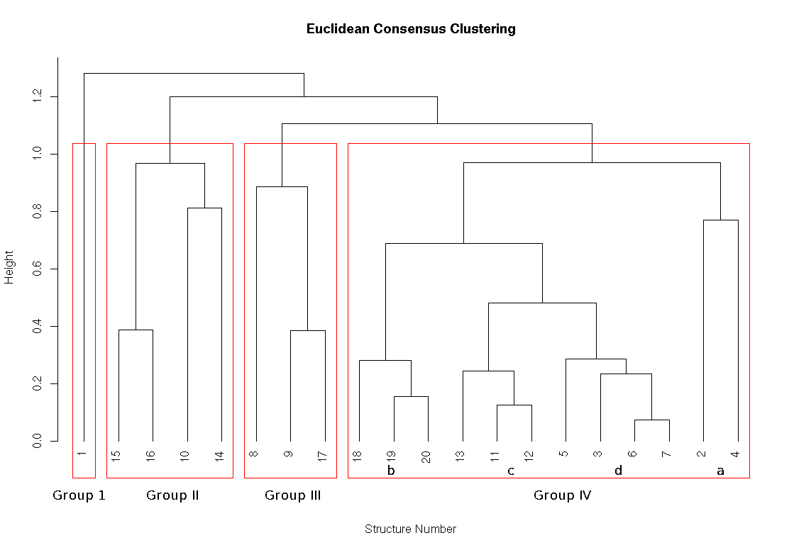
BASE STEPS Consensus clustering using classification techniques for the periodic table of the elements.

Slide 11
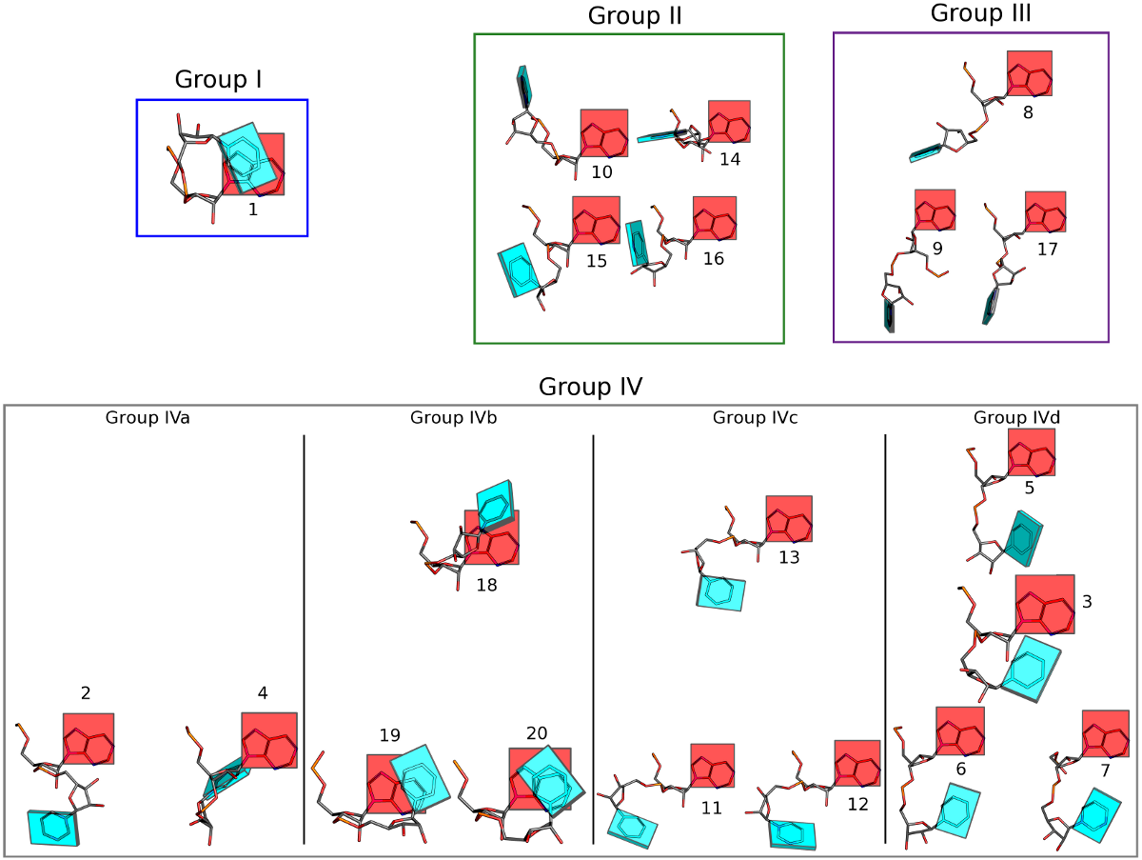

Slide 12
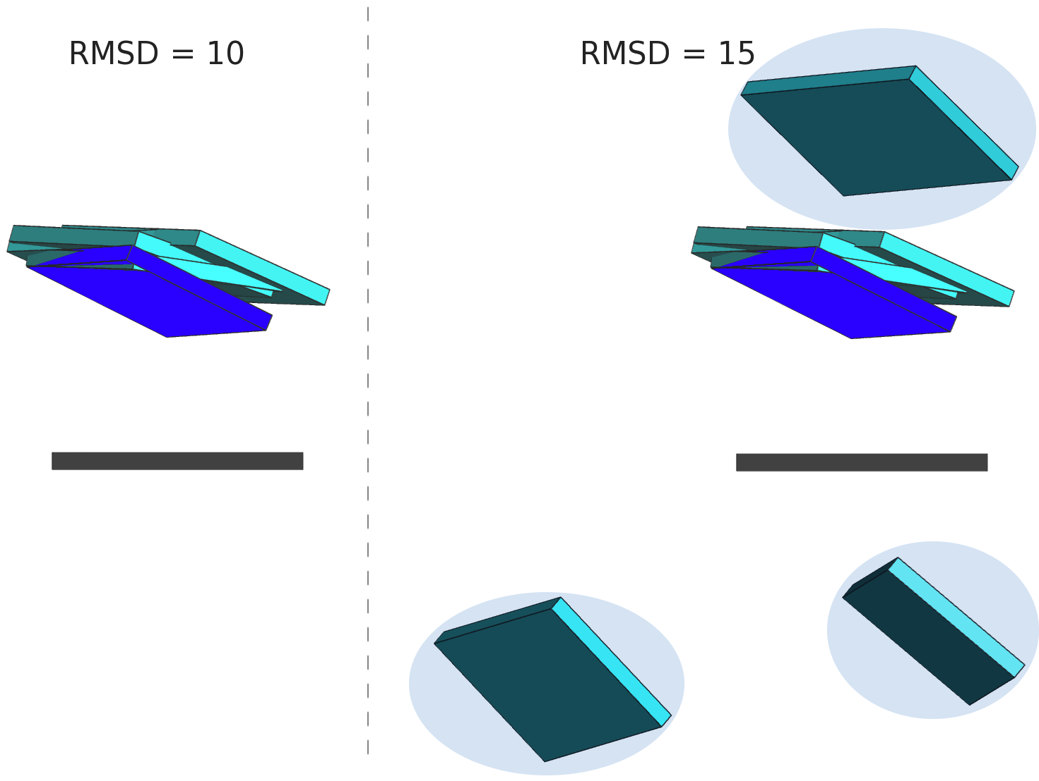
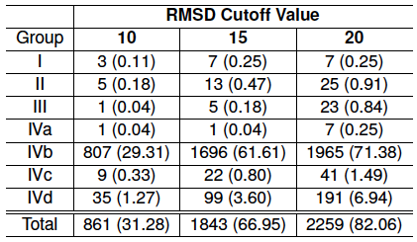
BASE STEPS Only a small fraction ~ 30 % of dinucleotide step conformations are represented in the ribosome.
In parentheses percentages of
confomer groups found in the 23S
subunit of the ribosome, PDB_ID: 1JJ2
Notes:
Subscript what’s in parentheses.

Slide 13
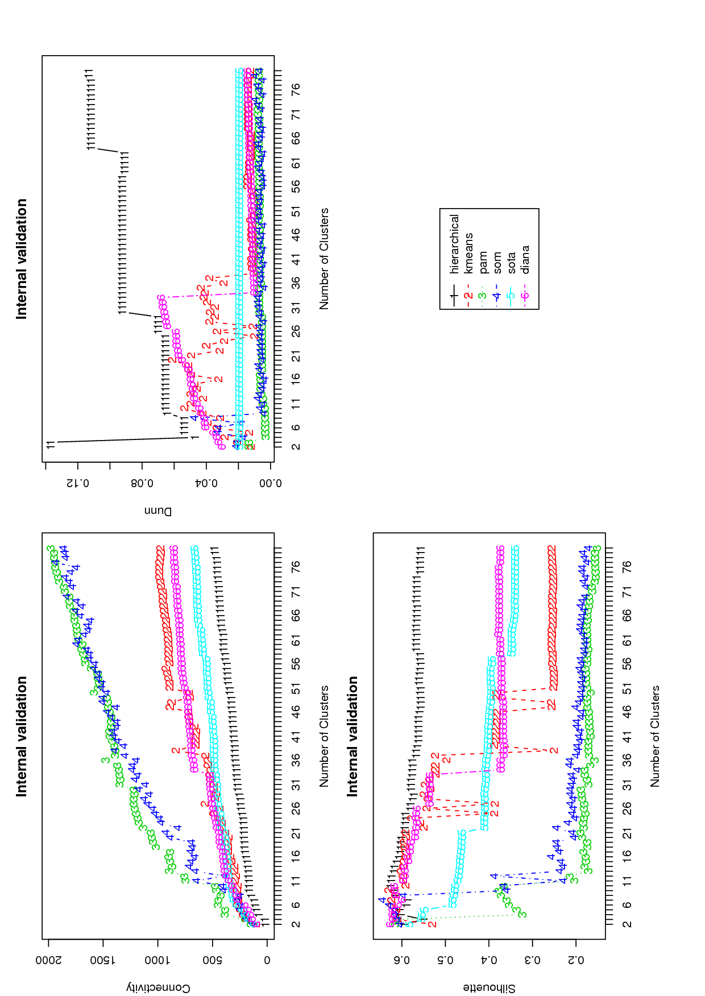
BASE STEPS Instead of picking any clustering methodology we use the clValid R package for cluster validation.
Label these
Connectivity is best smaller etc

Slide 14
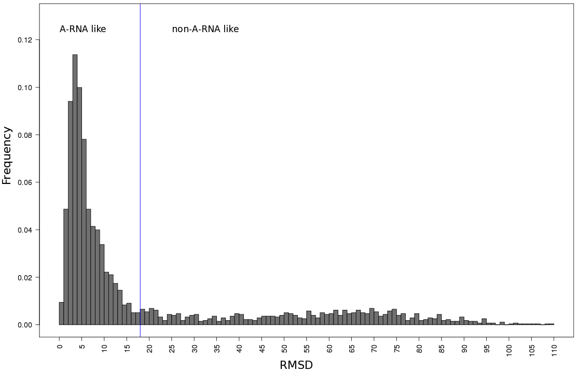
BASE STEPS Selecting A-RNA and non-ARNA-like datasets using distance to canonical ARNA parameters.
71% (1956)
29% (797)

Slide 15
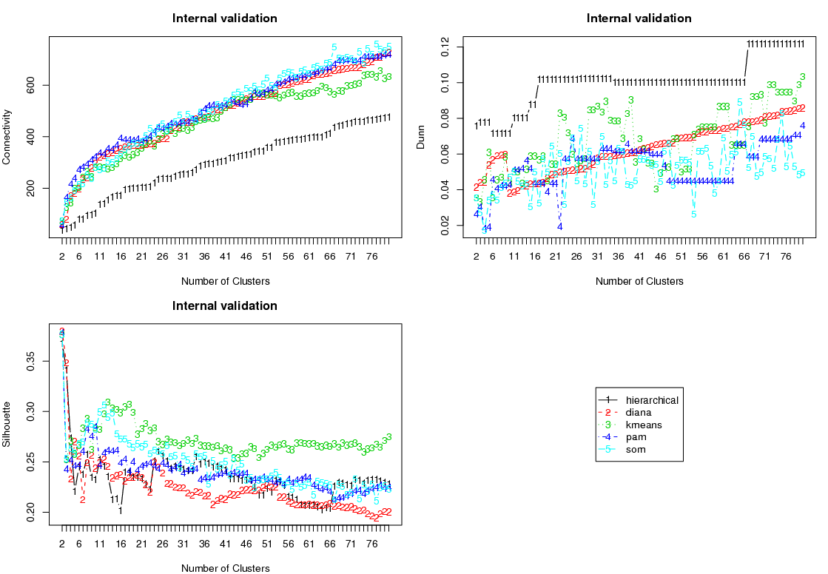
BASE STEPS For the non-A-RNA-like dinucleotide steps the best clustering method is the hierarchical one.
labels
Score better if
67 groups

Slide 16
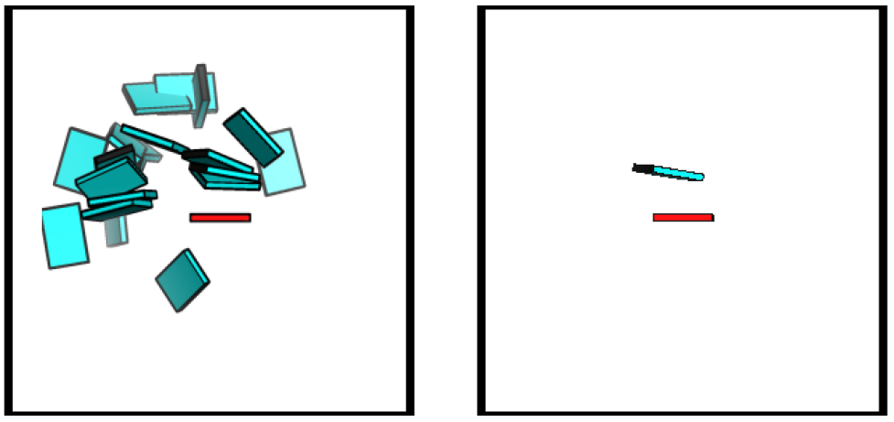
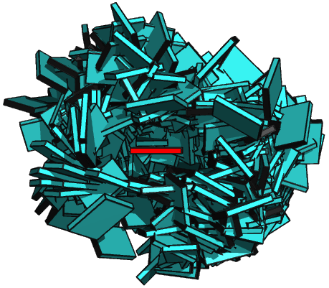
BASE STEPS Non-ARNA-like torsion angle conformers do not fill the full space of base geometries.
No-ball
Notes:
Type what are all the groups.
Show the 67 I get, as averages and show that they fill the space better.
Show picture of all.
How many in all non-ARNA

Slide 17
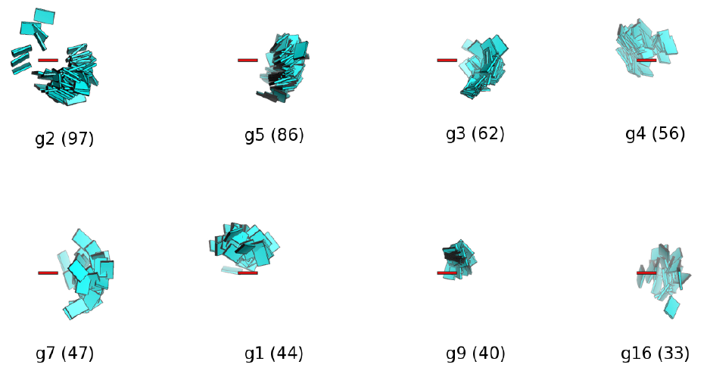
BASE STEPS There are 17 Main Non-ARNA-Like Clusters with ten or more members in them.
Percentages of this, better than just how many
What are the missing groups?

Slide 18
ACT II
Base-pairs in RNA helical regions

Slide 19
BASE PAIRS Helical regions in 3DNA can be continuous and quasi-continuous.
Picture of helical regions describe.
Quasi-continuous show pictures.
Base-pairing preferences, base-sequence preferences, in helical regiosn which can be linked to tertiary interactions.

Slide 20
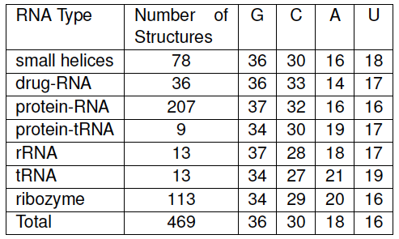
BASE PAIRS Partially non-redundant RNA dataset is GC rich
Percent composition of nucleotide bases in RNA
helical regions (Helices composed of 3 base-pairs or more).
Notes:
MESSAGE HERE THAT ITS GC RICH

Slide 21
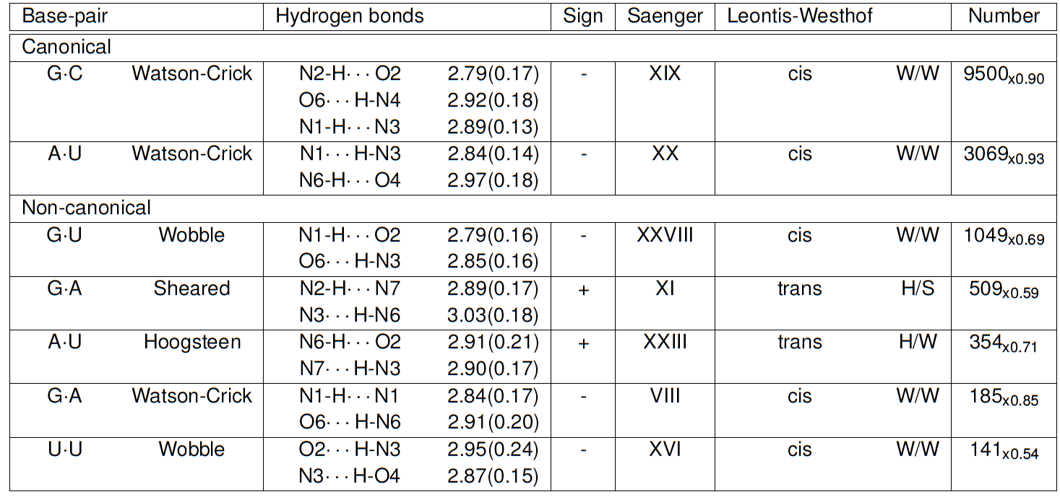
BASE PAIRS Seven Prominent Base-Pairs phrase in paper

Slide 22
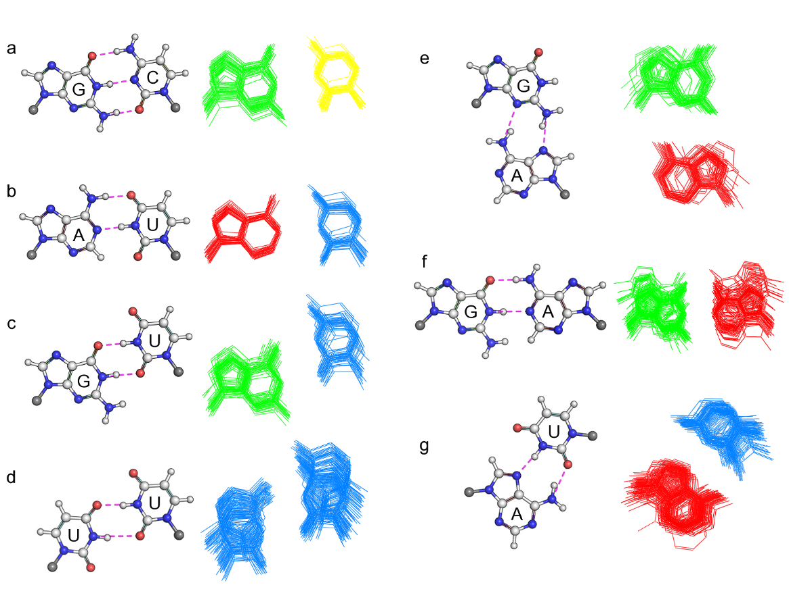
BASE PAIRS Non-canonical are more deformable.

Slide 23
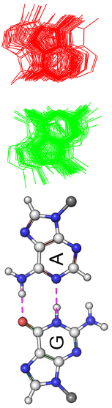
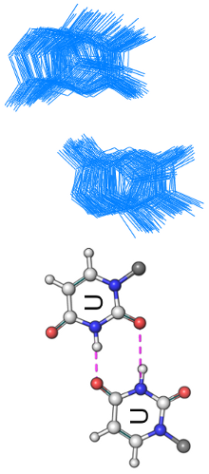
BASE PAIRS Average Base-Pair Parameters for the Seven.
Talk about analogy

Slide 24
ACT III
Base-pair-steps in RNA helical regions and RNA global properties

Slide 25
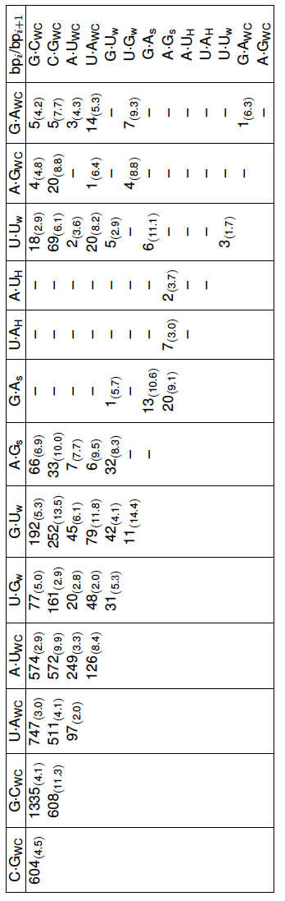
BASE PAIR STEPS RNA Base-Pairs Steps so Far
Message here: not all possible combinations are seen
Point to examples that stand out.

Slide 26
BASE PAIR STEPS RNA base-pair-steps parameters in helical regions and energy contours rnasteps website.
http://rnasteps.rutgers.edu

Slide 27
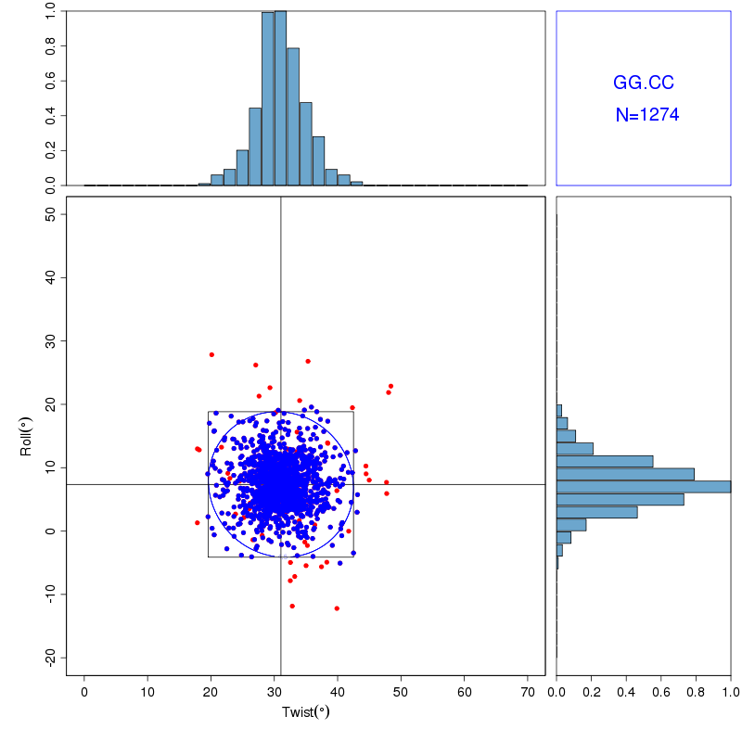
BASE PAIR STEPS Energy contours on data culled by three standard deviations from the mean.
Notes:
This will just go from going into the website.

Slide 28
Intermezzo

Slide 29
BASE PAIR STEPS – GLOBAL Knowledge of adjacent base-pair steps makes it possible to make up a larger polymer.
Picture with four–five steps, just to illustrate principle

Slide 30
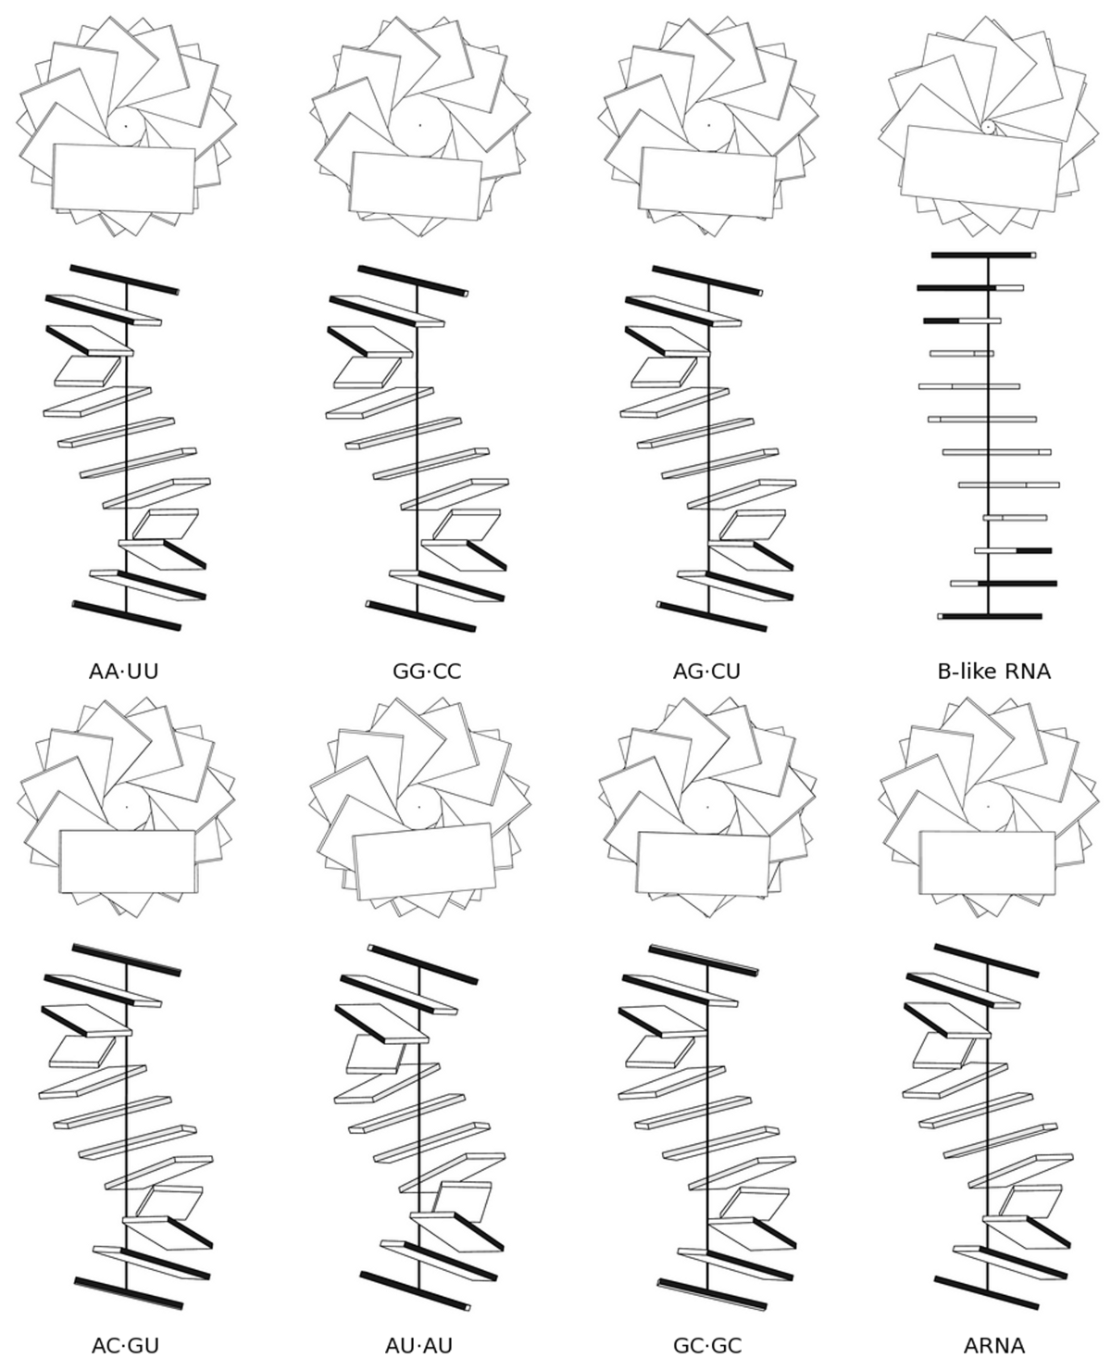
BASE PAIR STEPS – GLOBAL Homopolymers and Block Copolymers
Sequence has suttle effects on
Structure of RNA.

Slide 31
BASE PAIR STEPS – GLOBAL
Movie or graph to explain persistence length
Talk about flexibility.
Table of different polymers and their persistence lengths

Slide 32
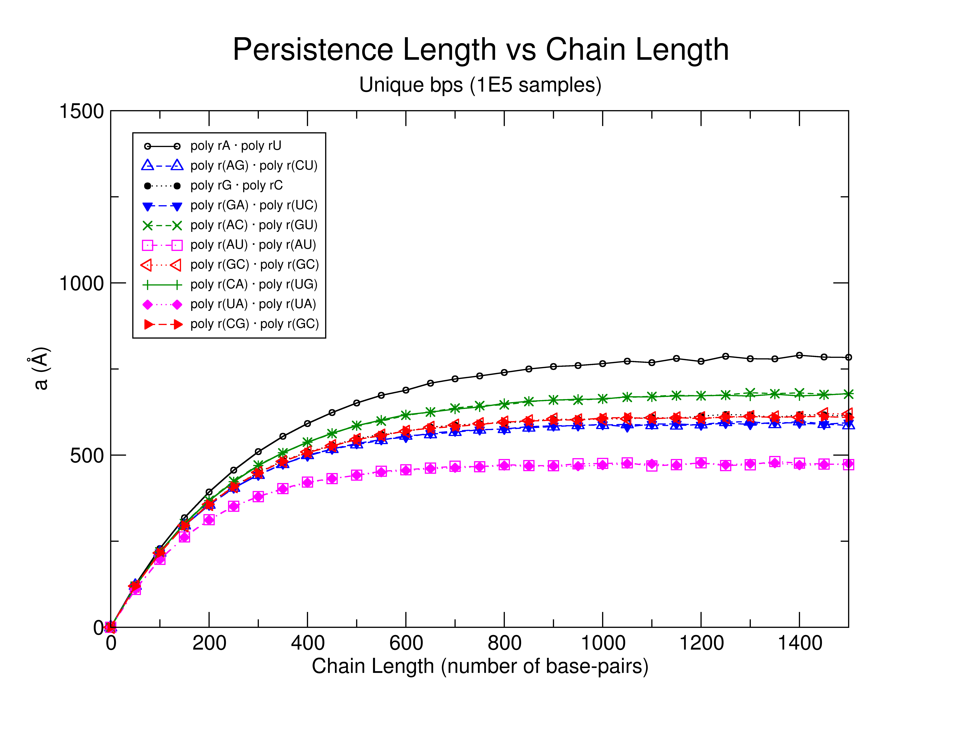
BASE PAIR STEPS – GLOBAL RNA Persistence Length
Message here
Suggest possible sequence
dependence

Slide 33
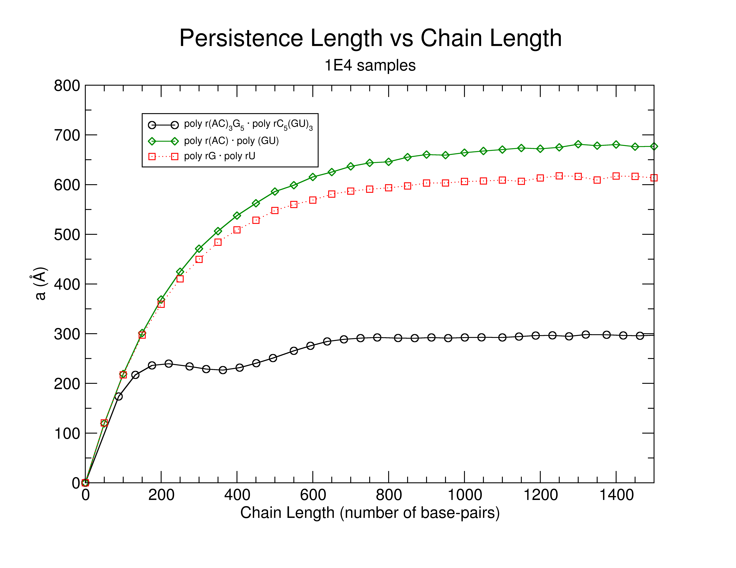
BASE PAIR STEPS – GLOBAL Message her of surprisingly some RNA messages appera to be curved RNA Chains
Notes:
FIX GRAPH

Slide 34
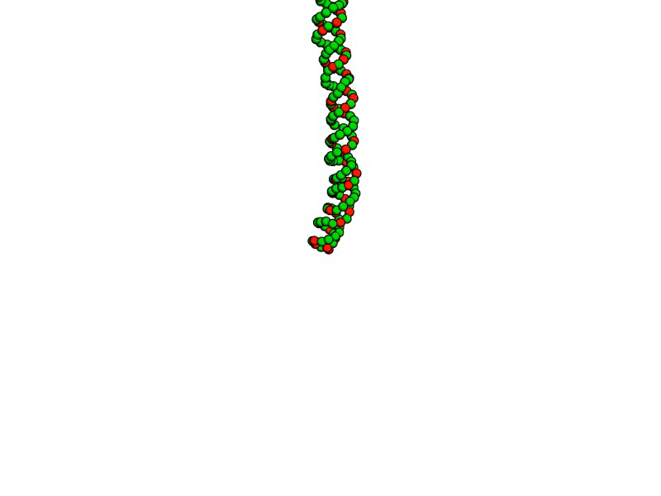
BASE PAIR STEPS – GLOBAL poly r(AC)₃ • poly r(GU)₃

Slide 35
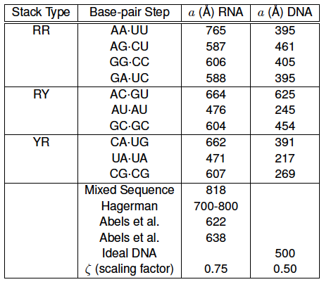
BASE PAIR STEPS – GLOBAL Modelled vs. Experimental a
Just what’s experimental what’s modelled
From x-ray strucutre analysis suggests that RNA is stiffer to

Slide 36
ACT IV
Finding RNA structural motifs using base step parameters.

Slide 37
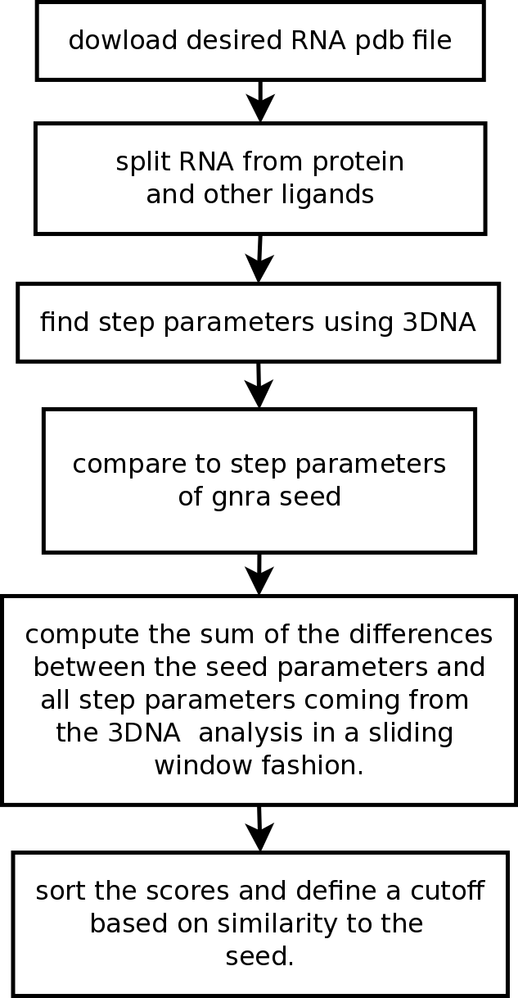
RNA STRUCTURAL MOTIFS getMotif
Message
Description of software

Slide 38
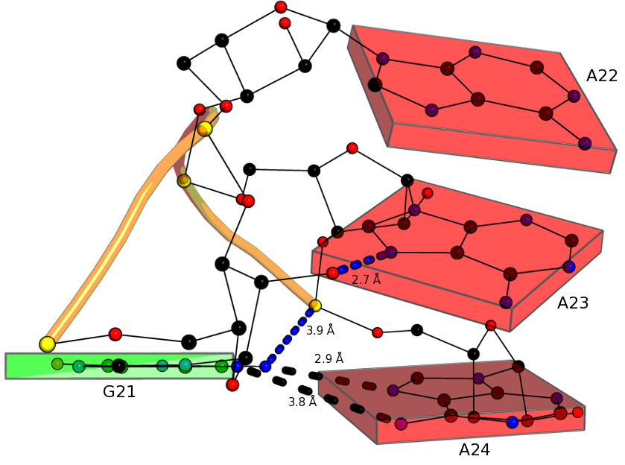
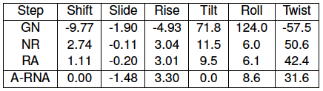
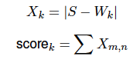
RNA STRUCTURAL MOTIFS Test GNRA Tetraloop Motif
GNRA Tetraloop provides
Good “toy” model
What do rigid body parameters
Tell you?

Slide 39
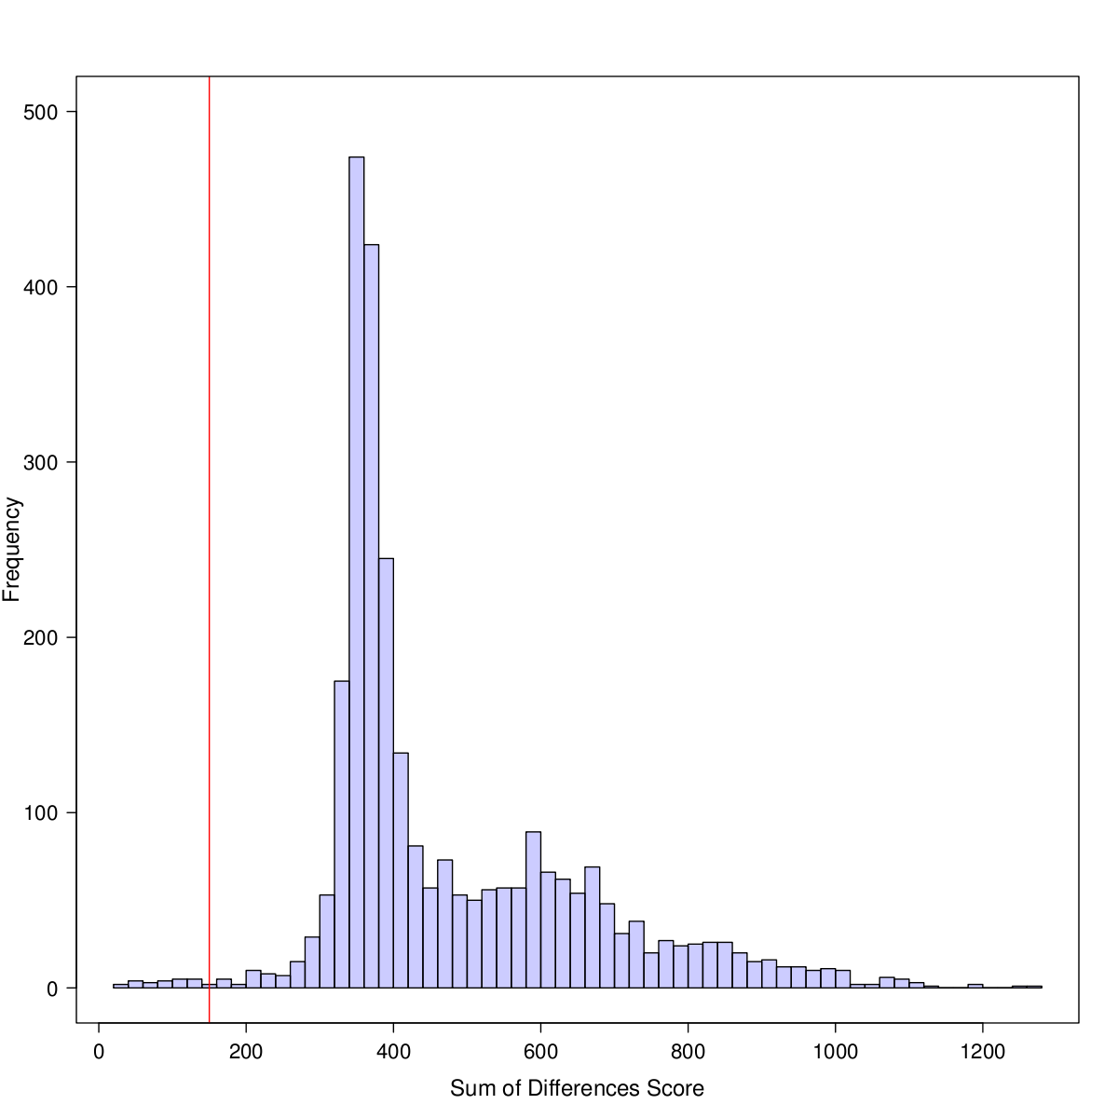
RNA STRUCTURAL MOTIFS Sum of differences score for a sliding window finds potential GNRA tetraloop motif candidates.
This is for 1FFK
Sliding windows image
Image with matrices in color
Boxes
e.g.
--- ---- ----
---- ---- -----
--- ---- ----

Slide 40
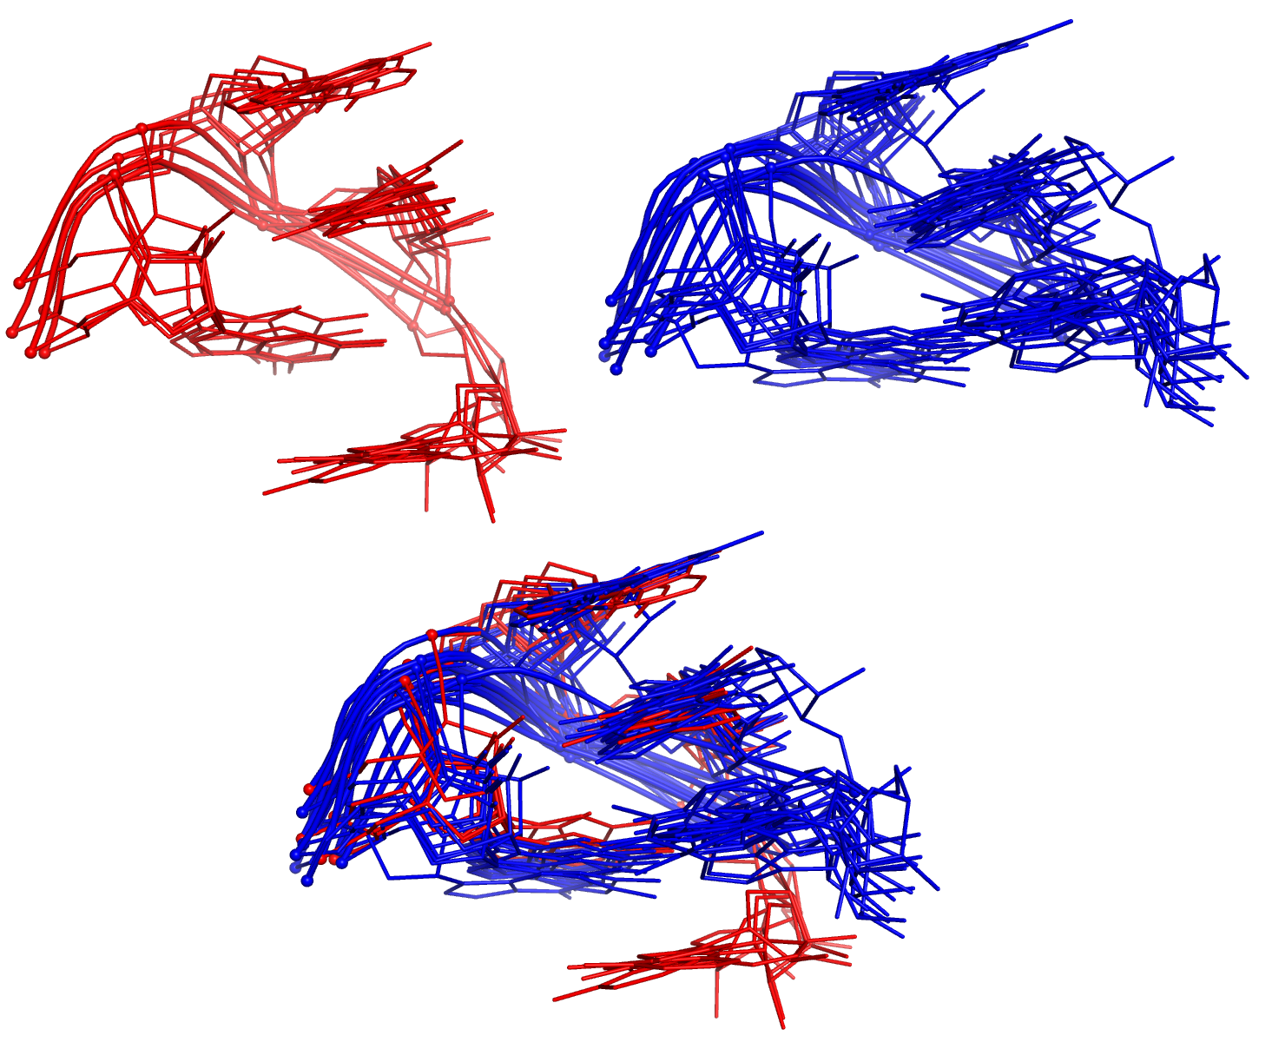
RNA STRUCTURAL MOTIFS The sum of differences score between single stranded base steps recognizes two GNRA groups.
Software recognixes this motifs
Add base in pentaloops and
Tell how many in other slide

Slide 41
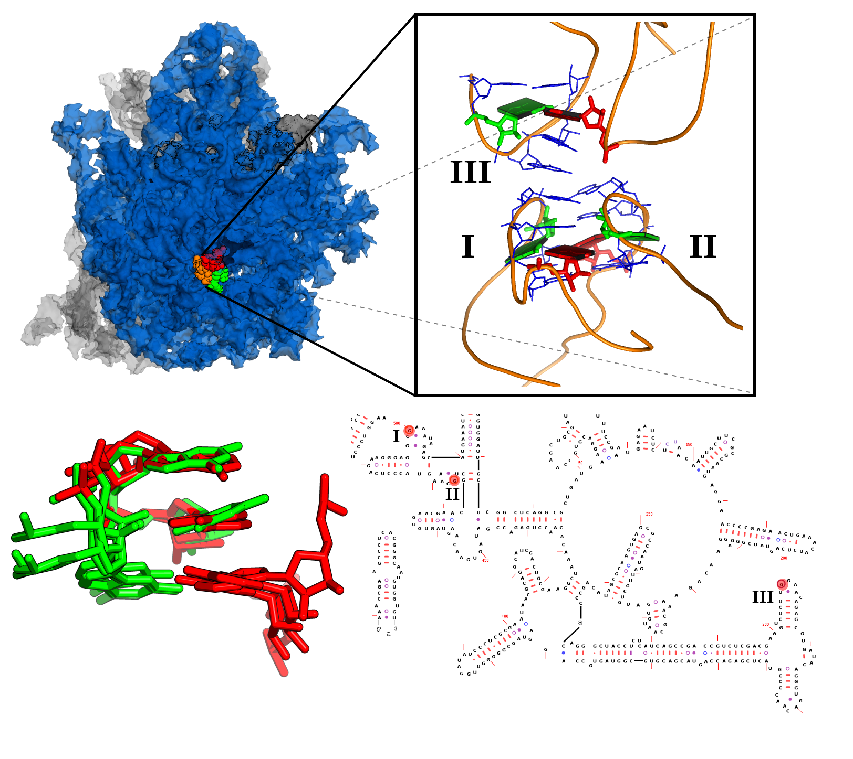
RNA STRUCTURAL MOTIFS Group II Candidate is Lone-Pair Triloop
This loops
Are ocurring
In such
Just use right side
If figure
In additional ribosome
In left.

Slide 42
Finale
Each act conclusion or message
Future, open questions. Coming attractions

Slide 43
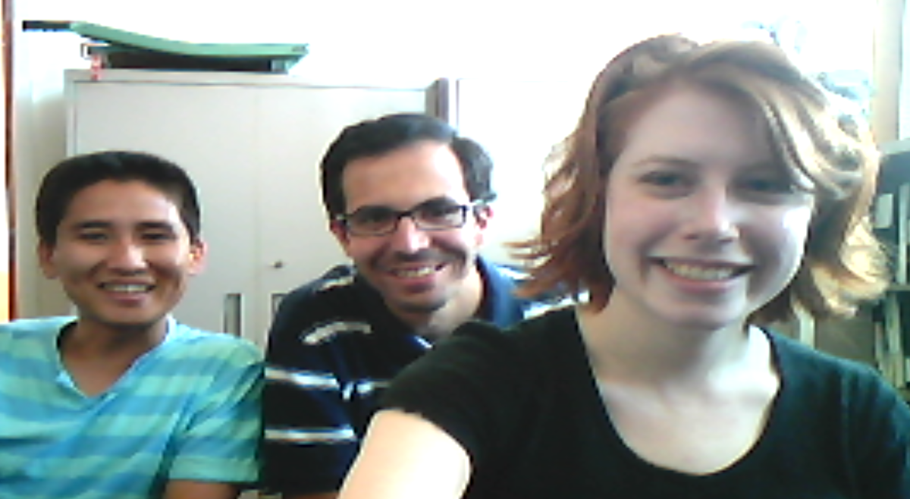
Thanks to my defense committee members for making it easy to schedule
this defense and your valuable time.
Special thanks to all members of the Olson Lab,
past and present.
Thanks to all for your attention,
Visit us at: http://dnaserver.rutgers.edu

Slide 44
